Slide 1
KDE DevRoom TALK
KOffice in Enterprise Environments
by
<Raphael.Langerhorst@kdemail.net>

Slide 2
Table of Contents
Warming up
What does KOffice offer to the Enterprise?
How Professional is KOffice today?
Key features for Enterprise Deployment
OpenDocument Format
Integration
Professional Business Applications
Lightweight, yet Most Complete office suite on earth
Recent Development Highlights
New Component with 1.5 release: KPlato
Full Scripting support
Krita rocketing to fame
Native OpenDocument Format

Slide 3
What's KOffice Anyway?
KOffice - Quick Guide
KOffice is a lightweight, complete, integrated, modern, professional office suite based on KDE Technology. It consists of the core library and the following set of integrated components:
Productivity: KWord, KSpread, KPresenter, Kexi
Creativity: Kivio, Karbon14, Krita
Management: KPlato
Supporting: KChart, KFormula, Kugar
KOffice is an open, standards compliant office suite. It has native support for the OpenDocument Format and is extendable through Plugins, Scripts and full Components - fully integrating.

Slide 4
Warming up - Why KOffice?
Why KOffice?
KOffice has many distinct features, including
Comparitively fast and lightweight
Complete set of Integrated Applications
Desktop Integration
Extendibility
Open File Format, no vendor lock-in
Quality

Slide 5
Warming up - Professional
The Professional Office Suite
Enterprise Database Applications with Kexi
Professional Painting and Image Manipulation with Krita
Managing and Planning with KPresenter, KSpread, KPlato and Kivio
Seamless Integration for individual needs - Plugins, Scripting
Quality

Slide 6
Key Features - ODF
OpenDocument Format
Open, XML based file format standard for office documents
Cooperation between major companies and individuals
including David Faure from the KOffice project
Approved OASIS Standard since 2005
Based on OpenOffice.org 1 XML file format
Provides companies with an open, vendor-independent file format
Already many implementations available

Slide 7
Key Features - Integration
Integration
KOffice is not just a mere bundeling of applications
Most components can be used to create combined documents
Desktop integration
Extendable through plugins, scripts and components
Seamless integration into the business workflow
Open XML file format

Slide 8
Key Features - Business Apps
Business Applications
Besides the usual office applications, KOffice offers components especially interesting for businesses.
Kexi for database applications
Krita for professional artists
Kivio, KPresenter for various business needs
Kugar for professional reports
KPlato for Project Management

Slide 9
Key Features - Complete
Complete Set of Integrated Applications
KOffice is the most comprehensive office suite,
providing the highest number of distinct, integrated applications.
KOffice thus covers a broad range of needs
Images and Graphics,
Databases,
Texts,
Spreadsheets,
Presentations,
(Project) Management & Planning
Charts
Reports

Slide 10
Key Features - Lightweight
Lightweight, after all !
Despite having so many components, KOffice is very lightweight
Twice as many components as OOo, but only one fifth lines of code
Fast application startup
Reasons for being lightweight
Based on KDE Technology
Quality - good code design
Small distribution size - better for distributors

Slide 11
Highlights - KPlato
KOffice 1.5 - first version shipping KPlato
KPlato provides lean and mean project management
Basic functionality implemented
Included in KOffice 1.5 as technology preview release
Gantt charts, Resources, (Sub-)Tasks, WBS, critical path/resources

Slide 12
Highlights - Accessibility
KOffice 1.5 has much improved Accessibility
Support in central applications for people with sight dissabilities
Integration of KTTS (KDE Text To Speech)
Accessibility is a requirement for public institutes and governments

Slide 13
Highlights - Krita
Krita is rocketing to fame
Krita development is so incredibly fast that it is a shock for maintainers of other image manipulation applications.
Krita is not just an image manipulation application - it's already more
Krita is becoming a Painter's Dream
Krita has become THE Photoshop alternative
Krita is, at the moment, the most active component of KOffice

Slide 14
Highlights - Kexi
Enterprise Database Applications with Kexi
Kexi has become THE MS Access alternative
Python scripting, Forms Designing, MS Access migration tools, ...
High Level Generic Database Layer (KexiDB)
Support for in-file databases (using SQLite), MySQL and PostgreSQL
Support for Server databases, with the schema stored in the server
Good database engine independency with KexiDB

Slide 15
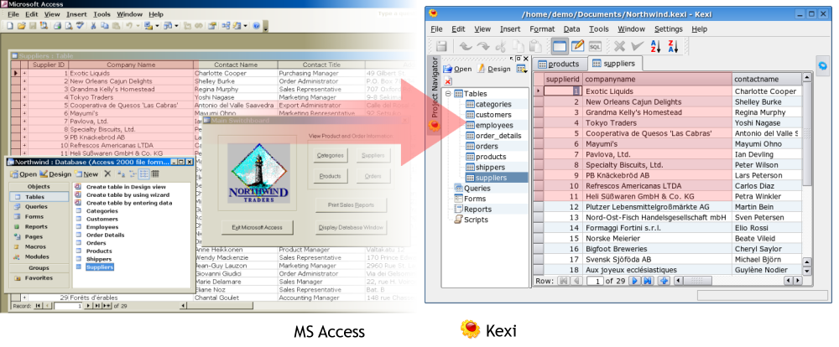
Highlights - Kexi Migration

Slide 16
Highlights - ODF now native
With KOffice 1.5, ODF is the native Format
The OpenDocument Format has become the industry standard for XML based office suite file formats
KOffice was the FIRST office suite in the world announcing support for the OpenDocument Format with its 1.4 release in 2005
With the KOffice 1.5 release, KOffice has switched to OpenDocument as its native format. It directly saves and loads ODF without filtering.
Since KOffice offers many more components than any other office suite, OpenDocument offers no specification for some KOffice components. These components use their own XML based format.

Slide 17
KOffice is The Future
KOffice is the Future, This is Why
Quality
Maintainability, because of Quality, this is the KEY point
Project Openness, supported by the community
Product Openness, KOffice is extendible and flexible
Standards Compliance, native ODF
High Quality base Technology - KDE
Integration
Ease of use
Lightweight
Beautiful User Interface

Slide 18
KOffice - Q & A
Questions & (hopefully) Answers
The Floor is Open for Discussions.
Thank you for your Attention
<Raphael.Langerhorst@kdemail.net>

